Slide 1
Creating Facebook Account & Page
Notes:
NOTE:
To change the image on this slide, select the picture and delete it. Then click the Pictures icon in the placeholder to insert your own image.

Slide 2
Register a Facebook Account
Visit facebook
Sign Up on the homepage
Fill your all the required information
Then hit the Sign Up button at the bottom of the page.
This is so that Facebook can contact you for confirmation of your registration and in future send you updates from your profile.

Slide 3
Why you Need Facebook Page
Pages are for brands, businesses, organizations and public figures.
To create a presence on Facebook, whereas profiles represent individual people.
Anyone with an account can create a Page or help manage one, if they've been given a role on the Page like admin or editor. People who like a Page and their friends can get updates in News Feed.

Slide 4
Create Facebook Page
Once your account is created.
Login into your account
Click the drop-down arrow on the toolbar, then select Create Page

Slide 5
Cont…
A list of categories will appear. Select the relevant category, enter the basic information for your organization, then click Get Started.

Slide 6
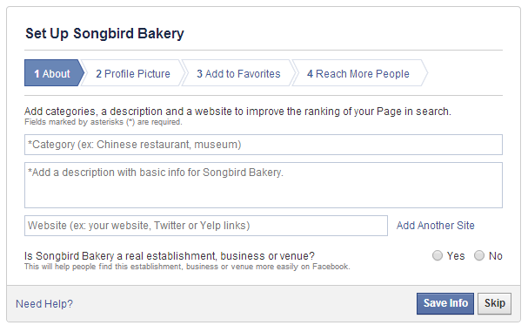
Cont….
The setup form will appear. Enter the requested information, then follow the steps to create your Facebook page.

Slide 7
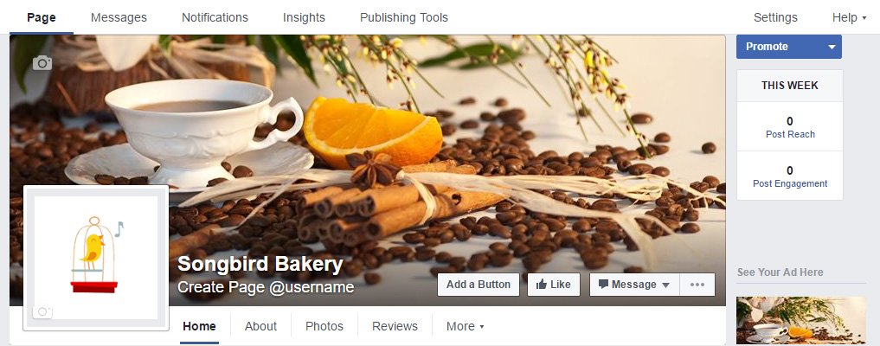
The Facebook page will appear. From here, you can customize your page, invite people to like the page, create posts, and much more

Slide 8
Page Roles
There are 5 different types of roles for people who manage Pages. When you create a Page, you automatically become the Page's admin, which means only you can change how the Page looks and publish as the Page. Only an admin can assign roles and change others' roles.
Keep in mind that multiple people can have roles on a Page, but each person needs their own personal Facebook account.
The table below outlines the 5 Page roles (across) and what they're able to do (down):

Slide 10
Assigning Page Role
Click Settings at the top of your Page.
Click Page Roles in the left column.
Type a name or email in the box:
If the person is your Facebook friend, begin typing their name and select them from the list that appears.
If the person isn't your Facebook friend, type the email address associated with their Facebook account.
Click Editor to select a role from the dropdown menu.
Click Save and enter your password to confirm.

Slide 11



